Slide 1
Stress Detection and Analysis Project
Depi Graduation Project
Documentation
EEG (Electroencephalogram) &
ECG (Electrocardiogram) data.

Slide 2
Table of Contents:
Overview
Requirements
Project Structure
Environment Setup
Data Management and Preprocessing
SQL Database Setup
Model Development
Visualizations
Pipeline and Deployment

Slide 3
1.Overview :
This project focuses on Stress Detection and Analysis using EEG (Electroencephalogram) and ECG (Electrocardiogram) data , Stress detection and analysis using biometric data is crucial for modern healthcare and wellness solutions.
The goal: classify stress levels based on EEG and ECG data, leveraging cloud-based infrastructure on Azure and deploying the final solution on Streamlit. The system will provide a scalable, accurate solution to monitor stress levels in real-time, potentially benefiting healthcare professionals and wellness applications.

Slide 4
2.Requirements : (Software and Tools)
1. Kaggle Dataset: We used Kaggle to find a suitable dataset for our project
2. Cloud: Azure (Blob Storage, Synapse Analytics, Data Factory, Machine Learning)
3. Docker: Needed for containerization of the application
4. Programming & Libraries: Python (Pandas, NumPy, Scikit-learn)
5. Deployment: Streamlit
6. Visualization: Power BI
7. Machine Learning Integration: Azure Machine Learning, Jupyter Notebooks

Slide 5
3.Project Structure:
The project involves several key components:
Azure Blob Storage: Used to store EEG and ECG data.
Databricks: Utilized for data preprocessing and analysis.
SQL: Used to query and manage data.
Machine Learning Models: Built to classify and detect stress.

Slide 6
Getting Started
To initiate the project, follow these steps:
Dataset Acquisition: We obtained the dataset from Kaggle, ensuring it met the requirements for our stress detection analysis.
Data Preprocessing: The data was preprocessed using Databricks to clean and prepare it for analysis.
Infrastructure Setup: We set up our cloud infrastructure on Azure, utilizing Blob Storage for data storage and Azure Synapse Analytics for data processing.
Model Development: Machine learning models were created using Python and relevant libraries to classify stress levels based on the preprocessed EEG and ECG data.
Deployment:Deploy the final model on Streamlit for easy user interaction. Create real-time dashboards using Power BI for visualization of the model’s predictions.

Slide 7
4. Environment Setup
Azure Resource Group & Storage Account:
A storage account named "stressdetectionstorage" was created, containing two containers: one for raw data (raw-data) and another for processed data (processed-data).
Commands for Resource Group and Storage Account creation:
Security: RBAC policies were implemented to control access.

Slide 8
1.Dataset Information
Data Collection
1.ECG: Recorded with a bipolar limb lead, band-pass filtered between 0.3-200 Hz, at a sampling rate of 1000 Hz.
2.EEG: Recorded using a cap with 8 electrodes, at a sampling rate of 2000 Hz.
Experimental Procedure
1.Habituation: Introduction to the experiment.
2.Baseline (EO): 5-minute relaxed state.
3.Low Stress (AC1): 5-minute arithmetic task.
4.Break: 2-minute relaxation.
5.High Stress (AC2): Repetition of the task with auditory distractions.
6.Recovery: 5-minute recovery.

Slide 9
Kaggle Dataset: ECG and EEG Stress Features
Feature Extraction
1.ECG: 11 features such as Heart Rate, RMSSD, and LF/HF Ratio were extracted.
2.EEG: Absolute and relative power in 7 frequency bands were calculated.
Dataset Structure
1.ECG(EO, AC1, AC2).xlsx: Contains 11 ECG features during different stress periods.
2.EEG(EO, AC1, AC2).xlsx: Contains absolute EEG power features from the electrodes.
3.Ratio of Alpha_Beta Power.xlsx: Includes relative EEG power features for alpha and beta bands across stress conditions.

Slide 10
5. Data Management and Preprocessing:
Exploratory Data Analysis (EDA):
Initial analysis and handling of missing data.
Azure Data Factory was used to move data to Azure Synapse Analytics for further processing.
Connecting Databricks to Azure Blob Storage:
Azure Blob Storage was connected to Databricks for preprocessing the ECG and EEG data , making the data accessible directly in Databricks without manual downloads.
OAuth 2.0 was used for authentication, ensuring secure access to Blob Storage.

Slide 11
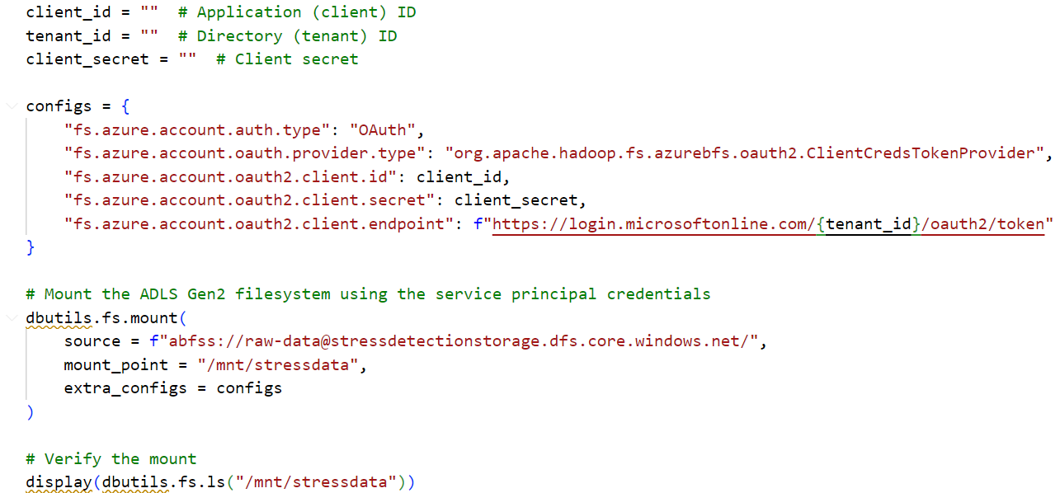
Example of mounting Blob Storage in Databricks:

Slide 12
. .
Preprocessing ECG Data:
The ECG data was organized into three segments: Baseline (EO), Low Stress (AC1), and High Stress (AC2).
The data was cleaned, merged across segments, and saved into Azure Blob Storage as CSV files for further analysis.
Preprocessing EEG Data:
EEG data was cleaned and important frequency bands (Delta, Theta, Alpha, Beta, Gamma) were extracted for each electrode.
The preprocessed EEG data was saved in Azure Blob Storage for easy access.

Slide 13
. .
Ratio of Alpha to Beta Power:
This metric was calculated and reshaped to quantify mental workload and stress levels.
The final dataset was saved in Blob Storage for future model training.
Security Measures:
OAuth 2.0 Authentication: Azure’s DefaultAzureCredential was used for secure access to Blob Storage.
Environment variables were used to store sensitive credentials, ensuring secure access.

Slide 14
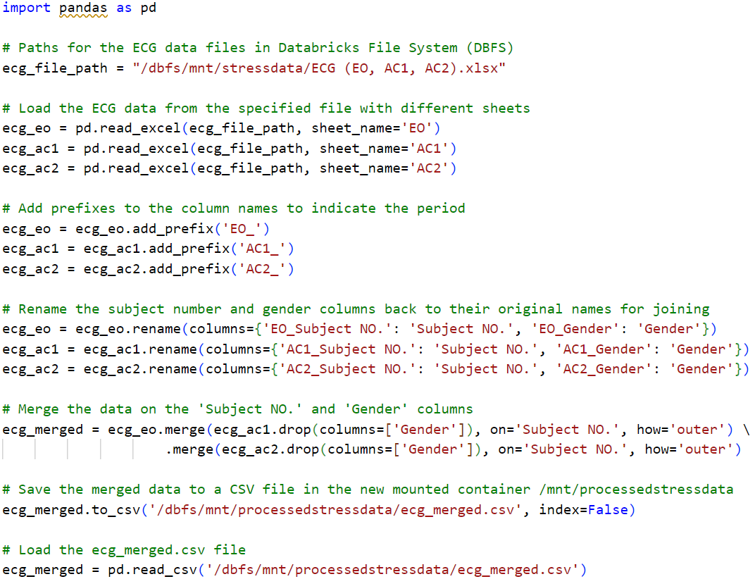
ECG

Slide 15
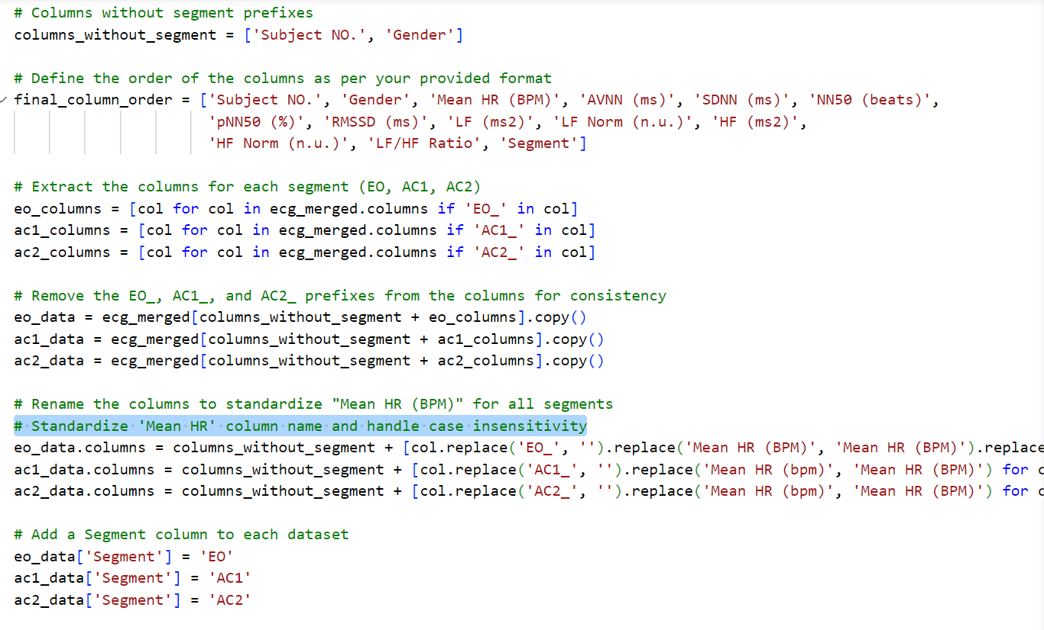
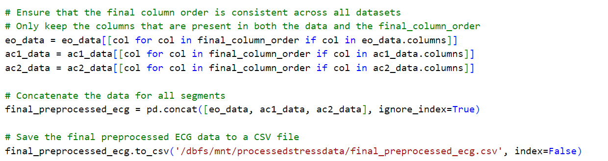

Slide 16
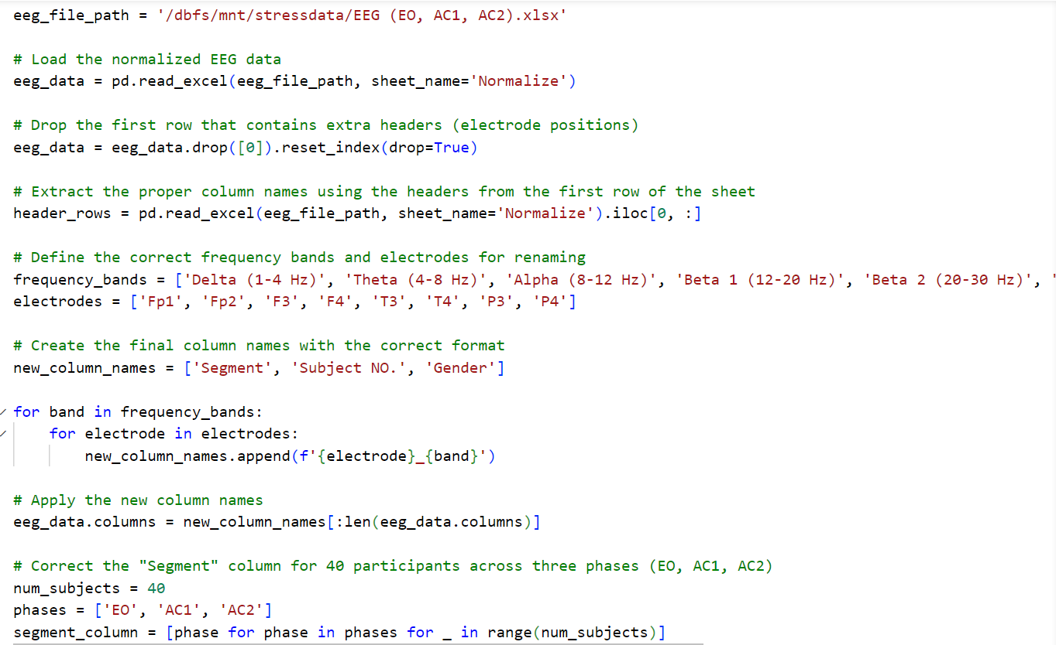
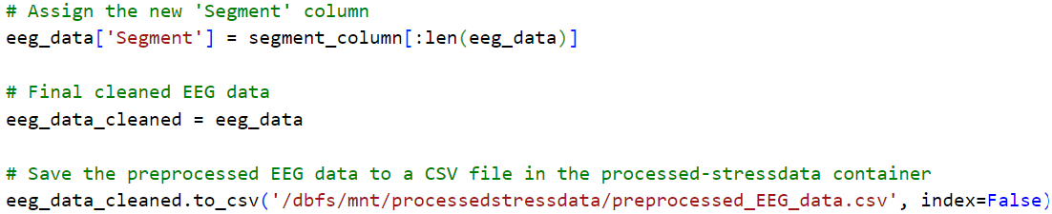
EGG

Slide 17
6. SQL Database Setup
Azure Data Warehouse Implementation:
Set up Azure Synapse Analytics for efficient storage.
Data Integration:
Use Azure Data Factory for data pipelines to move data to the data warehouse.
Deliverables:
Functioning data warehouse with integrated data.
SQL scripts for data verification.

Slide 18
Steps
Database Setup
creating a database for stress detection based on EEG and ECG data. The process includes creating tables using stored procedures, importing data into these tables, and automating these tasks using Python scripts.
Database Creation
Creating Schemas
Creating Tables for ECG and EEG Data
Stored Procedures
Data Insertion
Verification

Slide 19

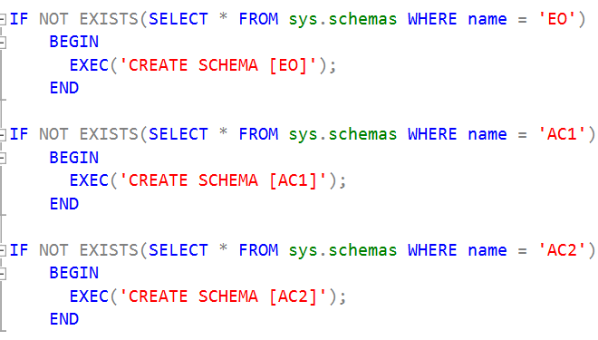
Step 1:Database Creation
Step 2:Creating Schemas
Schemas were created to organize the data for easy management. For instance, ECG and EEG data are stored in separate schemas

Slide 20
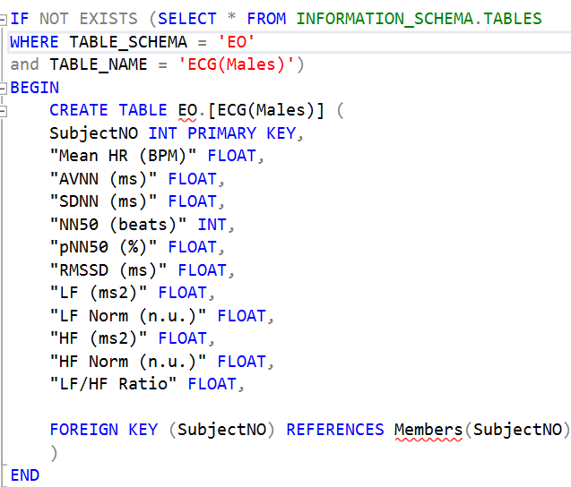
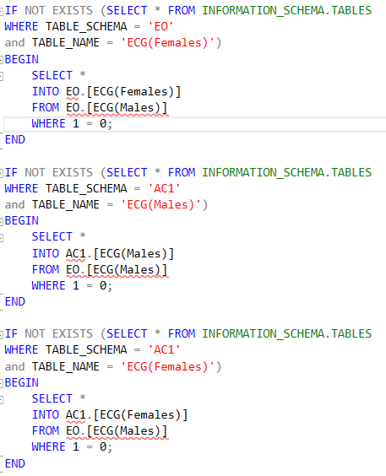
Step 3:Creating Tables for ECG and EEG Data
ECG Tables: SQL scripts were used to create tables for storing the processed ECG data, including key metrics like heart rate variability (HRV), AVNN, LF/HF Ratio, etc.
SQL script for creating the ECG table:

Slide 21
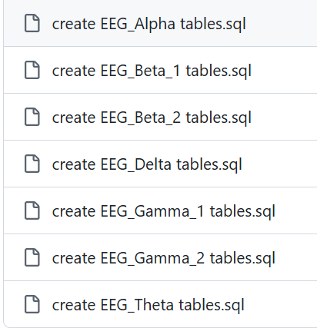
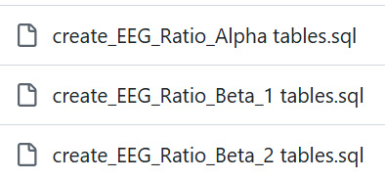
EEG Tables: Separate tables were created for different EEG metrics such as Alpha, Beta, and Gamma brain waves. There are also tables for the ratio of Alpha to Beta power for stress analysis.
These are tables created
within the EEG:
These are the tables created
within the Egg Ratio Table

Slide 22
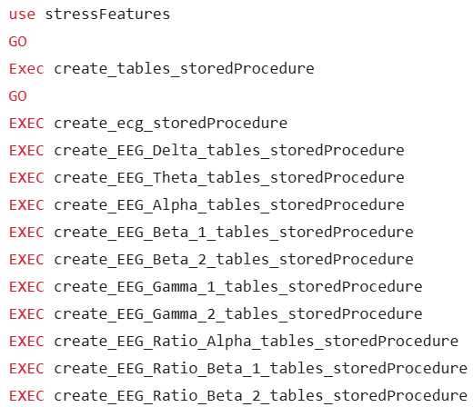
Step 4:Stored Procedures
Stored procedures were written to automate table creation and data insertion processes. This simplifies repeated tasks by allowing the user to execute stored procedures without manually writing SQL code each time.
executing a stored procedure to create ECG ,EGG tables:
Ex of inserting data using stored procedures:

Slide 23
Step 5:Data Insertion
Python scripts were used to load the processed data from CSV files (preprocessed ECG and EEG data) and insert it into the respective SQL tables using pyodbc to connect Python with SQL Server.
Insert Members Data
Use the insert_into_members.py script to insert member information into the Members table. Ensure the connection details are correct.
Insert ECG Data
Use the insert_into_ECG.py script to insert ECG data into the ECG table. Ensure the final_preprocessed_ecg.csv file is available.
Insert EEG Data
Use the insert_into_EEG.py script to insert EEG data into the respective EEG tables. Ensure the preprocessed_EEG_data.csv file is available.
Insert EEG Ratio Data
Use the insert_into_ratio_EEG.py script to insert EEG ratio data. Ensure the preprocessed_ratio_alpha_beta_power.csv file is available.

Slide 24
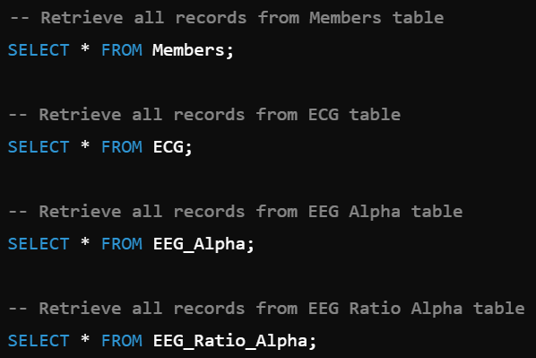
Step 6:Verification
After inserting data, verification was done by running SQL queries to check that the data has been correctly inserted into the tables.
Example query to verify the data:

Slide 25
7. Model Development
This section covers the development of the stress detection model using Long Short-Term Memory (LSTM) networks, specifically focusing on classifying stress levels based on EEG and ECG signals.
The model is designed to analyze sequential physiological data (EEG & ECG) and predict whether a subject is stressed. The LSTM architecture is chosen due to its capability to handle time-series data, learning patterns, and temporal dependencies.

Slide 26
7.2 Model Architecture
The LSTM model is composed of the following layers:
LSTM Layers: Capture and learn sequential dependencies from the time-series data.
Dropout Layers: Prevent overfitting by randomly deactivating neurons.
Dense Layers: Fully connected layers that reduce dimensionality for final classification.
Output Layer: A Sigmoid function provides binary classification of stress (stressed or not stressed).
Adam Optimizer: With a learning rate of 0.0003, it optimizes the network's weights, and gradient clipping is applied for training stability.

Slide 27
Model Configuration:
LSTM (128 units, return_sequences=True) → Dropout (50%) → LSTM (64 units) → Dense (128 units, ReLU) → Dropout (40%) → Dense (64 units) → Sigmoid Output.
Optimizer: Adam with a learning rate of 0.0003.
Loss Function: Binary Cross-Entropy.
LSTM:
LSTM networks excel in processing sequential data like EEG/ECG, preserving long-range dependencies, and are resistant to the vanishing gradient problem, which is common in long sequences.

Slide 28
7.3 Data Preprocessing
To prepare the data for the LSTM model:
Feature Selection: Recursive Feature Elimination (RFE) to select key physiological features.
Normalization: Ensure consistency in feature scaling across datasets.
Reshaping: Data is reshaped into sequential formats to align with LSTM input requirements.

Slide 29
7.4 Training and Evaluation
The model was trained using:
Epochs: 150
Batch Size: 16
Metrics: Accuracy and F1 score for evaluating model performance.
Callbacks:
ReduceLROnPlateau: Reduces learning rate upon plateauing.
EarlyStopping: Stops training when no improvement is seen for 10 epochs.

Slide 30
7.5 Results
The model was tested across multiple datasets for both male and female subjects under different conditions (e.g., EO, AC1). Results demonstrated high accuracy in stress detection based on EEG and ECG signals.
Ensure the following dependencies are installed:
Python 3.x
TensorFlow 2.x
NumPy, Pandas, Scikit-learn, Matplotlib
7.6 System Requirements

Slide 31
7.7 Future Directions
Possible improvements include:
Implementing more advanced models like GRUs or combining LSTM with CNNs.
Expanding the system for real-time stress detection using live EEG/ECG data.
Increasing dataset diversity to improve model generalization.

Slide 32
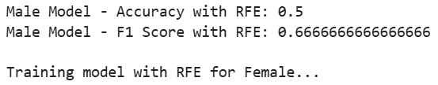

The model's performance was evaluated on the test dataset, and the accuracy achieved is shown .
This metric reflects the model's ability to correctly classify stress levels based on EEG and ECG signals.
EO VS AC1,AC2
EO VS AC1 & EO VS AC2

Slide 33
8. Visualizations
1. Dataset Description: The data consists of combined EEG (Electroencephalogram), ECG (Electrocardiogram), and Alpha-Beta power ratio information. This data was preprocessed to help understand the relationships between stress levels and features such as heart rate variability (HRV) and brainwave activity. The dataset also includes demographic features like gender.
Objective: The main goal is to visualize and explore the relationship between features (such as HRV, EEG, ECG) and how they relate to stress levels, gender differences, and other physiological responses under different conditions.

Slide 34
2. Libraries Used
Matplotlib and Seaborn are the primary libraries used for creating visualizations to explore the relationships between the features in the dataset.
3. Visualizations Overview
Gender Distribution: A count plot was generated to show the gender distribution in the dataset, highlighting the number of male and female participants.
Stress Condition Distribution: This visualizes the distribution of stress conditions labeled as EO (Baseline/Non-Stress), AC1 (Low Stress), and AC2 (High Stress). This helps compare the number of samples for each condition, ensuring balanced datasets for further analysis.
4. Feature Analysis
Correlation Heatmap: A correlation map was created to analyze the relationships between features like HRV, EEG bands, and stress conditions. This helps in identifying any potential links between physiological and brainwave data.

Slide 35
Bar Charts and Boxplots:
Gender Differences: Bar charts and boxplots were used to understand how heart rate variability (HRV), EEG, and ECG signals vary by gender, showing patterns like slightly higher HRV in females during certain stress conditions (AC1).
HRV Changes: Boxplots were used to visualize how HRV changes under different stress levels (EO, AC1, AC2). Results showed that as stress increased, heart rate variability decreased, indicating a more consistent heart rate under stress.
Segment Analysis:
A specific analysis was conducted on segments for the same subject. For example, subject 5 had their EEG/ECG data visualized across conditions EO, AC1, and AC2, highlighting the differences in their stress levels, particularly in terms of bandwidth.
Visualizations compared male and female subjects, further showcasing differences in physiological responses.

Slide 36
5. Brainwave Analysis
EEG Power Band Analysis: Boxplots showed how Alpha and Beta power changed across stress conditions. The results suggested that Alpha power tends to decrease with higher stress levels, while Beta power remained relatively stable with minor variations.
Alpha Power and Stress: A combination of violin plots and bar plots was used to show the distribution and average Alpha power across different stress conditions, illustrating the inverse relationship between Alpha brainwave activity and stress.
6. Physiological Responses to Stress
Sympathetic vs Parasympathetic Activity: Bar plots were used to explore how stress affects the balance between the sympathetic and parasympathetic nervous systems (LF/HF ratio). Higher stress conditions led to an increased LF/HF ratio, indicating greater sympathetic dominance (a typical stress response).
Gender Differences in LF/HF Ratio: A boxplot visualized the LF/HF ratio by gender, showing that males exhibited a higher LF/HF ratio than females, suggesting gender-specific differences in stress responses.

Slide 37
9.PIPELINE
The data processing pipeline for the Stress Detection and Analysis project consists of several key stages that facilitate the smooth transition from raw data to insights. This pipeline includes the following steps:
1.Data Ingestion: Raw data is collected from various sources, including ECG and EEG signals, and saved in a structured format for processing.
2.Preprocessing: In this stage, the data is cleaned and transformed. The preprocessing includes:
Normalizing ECG and EEG signals to bring them into a uniform scale.
Reshaping the data to prepare it for model training, ensuring that all features are properly aligned.

Slide 38
3.Feature Engineering: Relevant features are extracted and selected to improve model performance. This includes using techniques like Recursive Feature Elimination (RFE) to identify the most significant features for the classification task.
4.Model Training: The processed data is used to train machine learning models. In this project, we employed a hybrid LSTM model to classify stress levels based on the physiological signals.
5.Deployment: The trained model is deployed using Docker, ensuring that the application runs consistently across different environments. Docker simplifies the deployment process by encapsulating all dependencies within a container.
6.User Interface: A user-friendly interface is created using Streamlit, allowing users to easily select their gender and input the relevant features for classification. The Streamlit app provides real-time predictions based on the input data.

Slide 39
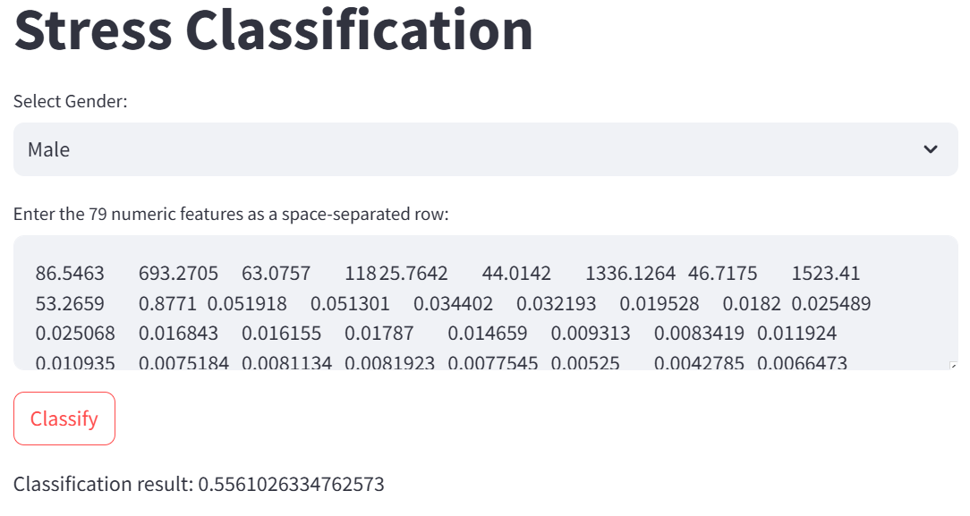
Summary of Implementation
This pipeline effectively integrates various stages of data processing and model deployment, leading to an efficient workflow from data collection to classification. By leveraging Docker for deployment and Streamlit for the user interface, the project ensures a seamless experience for end-users and facilitates easy access to stress classification insights.

Slide 40
9. Deployment
1. Prerequisites
Before starting the deployment process, ensure you have the following items:
Docker installed on your machine or server.
A requirements.txt file containing the required libraries:
tensorflow==2.16.1
keras==2.16.1
streamlit
numpy
joblib

Slide 41
2. Project Structure
Ensure that the project structure contains the following files and folders:
app.py # Main application file
model_Female.h5 # AI model for female
model_Male.h5 # AI model for male
requirements.txt # List of required libraries
Dockerfile # Docker setup
3. Docker Setup
3.1. Dockerfile Configuration
Make sure you have a Dockerfile
3.2. Build Docker Image
Build the Docker image using the command line:
docker build -t stress-classification-app .

Slide 42
3.3. Run Docker Container
After building the image, run the container using the following command:
docker run -d -p 8501:8501 --name stress-classification-app stress-classification-app
3.4. Access the Application
Once the container is running, you can access the Streamlit application from your browser using the following link:
http://localhost:8501

Slide 43
Team Member Responsibilities
Team Members
1. Abdelrahman Ashraf
2. Omar Khalifa
3. Ahmed Ismail
4. Esraa Mamdouh
5. Tasneem Mahmoud
1. Abdelrahman Ashraf : Machine learning model development
2. Omar Khalifa : Data preprocessing
3. Ahmed Ismail : SQL queries
4. Esraa Mamdouh : visualization & documentation & presentation
5. Tasneem Mahmoud : Pipeline & Streamlit deployment

